Slide 1
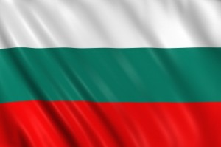
GFS
Bulgaria

Slide 2
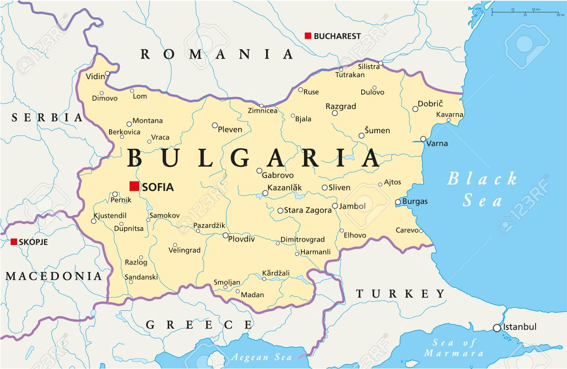
Outline
Bulgaria
Sight‘s
Food
Clothes
End

Slide 3
Bulgaria
Bulgaria is in the south east.
7.1 million people.
The capital city is Sofia.
The area is 110.994 square kilometers.
The currency is lew.
EU-Member state since 1 January 2007.
The people speak bulgarian.

Slide 4
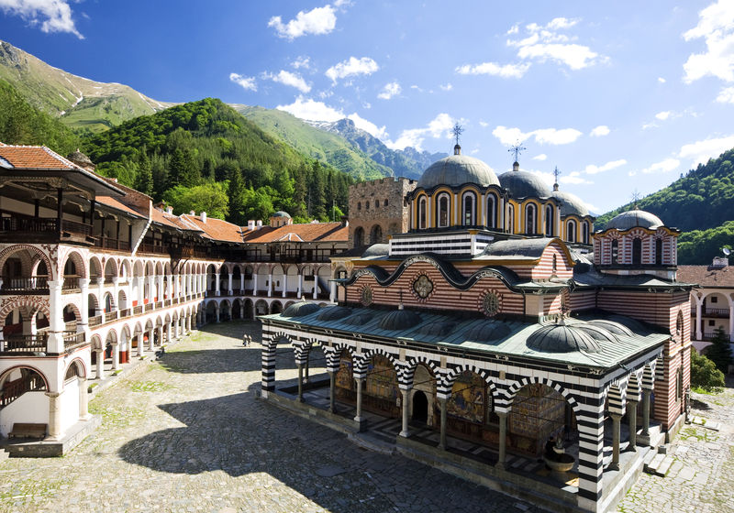
Sight‘s
Monastery Rila (Рилски манастир)

Slide 5
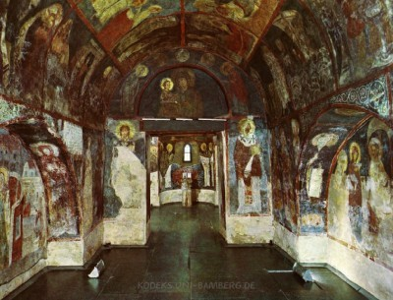
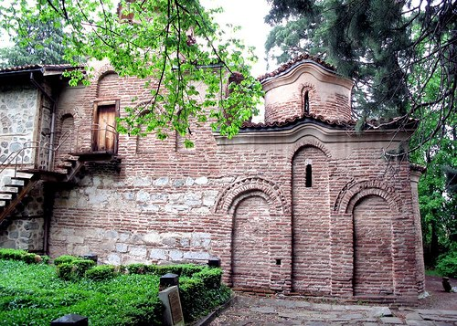
Sight‘s
Church Bojana

Slide 6
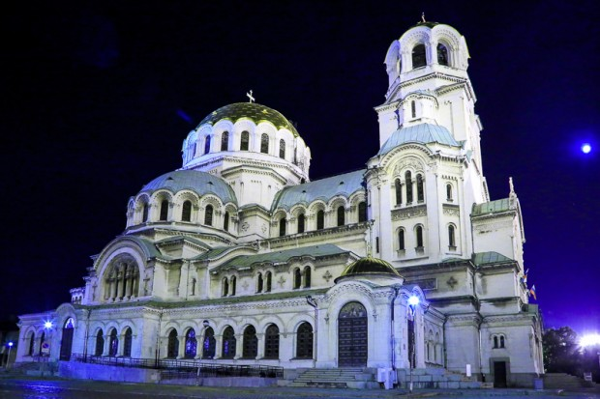
Sight‘s
Alexander-Newski-cathedral

Slide 7
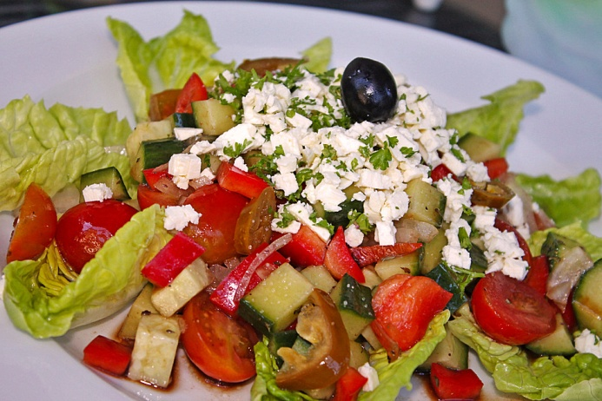
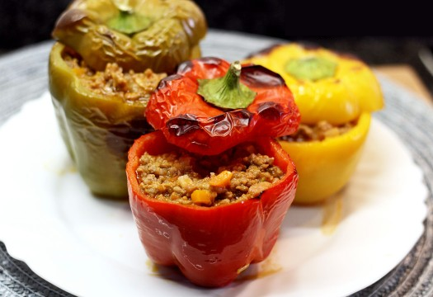
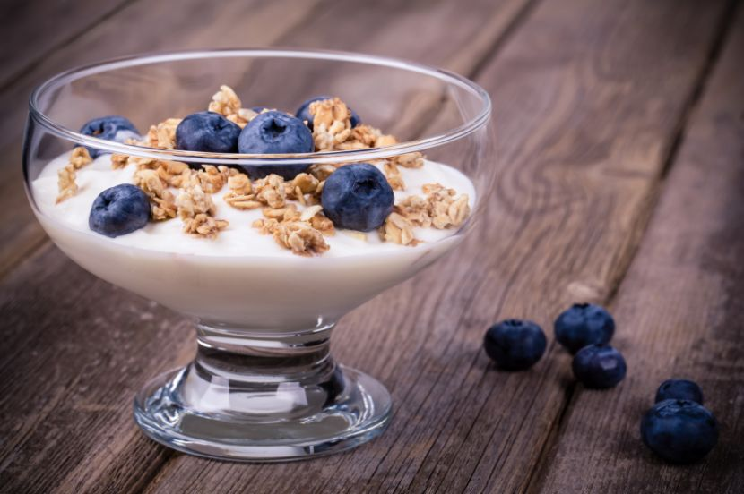
Food
Schopska salat
Palneni tschuschki
Desert

Slide 8
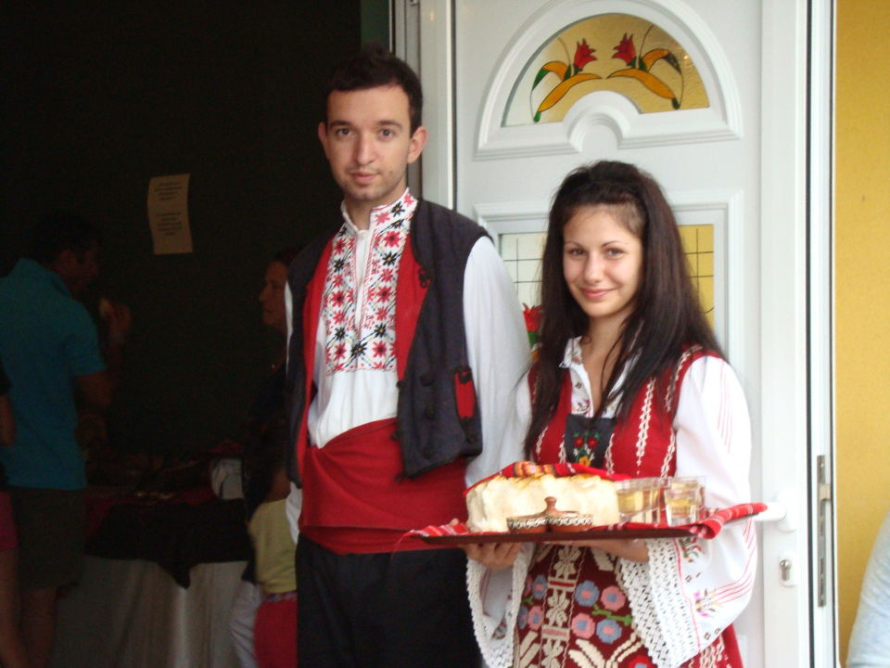
Clothes
Woman:
Man:

Slide 9
End
By: Liam

