Slide 1
Palermo
The Erasmus+ project
A journey to Palermo, Italy

Slide 2
Table of Contents
Information about Palermo
What is Erasmus+ ?
The arrival
Daily diary entries
The lifestyle
The departure
My opinion
My sources

Slide 3
Information about Palermo

Slide 5
What is Erasmus+ ?
Community makes strong!
Countries that take part in
France
Italy
Germany
Greece
Cyprus
Bulgaria

Slide 6
The arrival

Slide 7
Daily diary entries
Sunday 20.11.16 | Monday 21.11.16 | Tuesday 22.11.16 | Wednes. 23.11.16 | Thursday 24.11.16 | Friday 25.11.16 | Saturday 26.11.16 | Sunday 27.11.16
 | 08:15 a.m School 09:00 a.m guide through Norman- nenpalace With Chapel & rooms Of King/Dom St.Cataldo | 09.00 a.m Receiving of the Delegations&Presentations 09:30 a.m - 12:20 a.m Sporty activities in School Meeting of Coordinators | 08:00 a.m School Departure to Mozilla 09:30 a.m- 11 a.m visiting the old Phoenician islands 11:30 a.m- 12:30 a.m Marsala | 08:30 a.m School Botanical Garden,the marina, old port.Monte Pellegrino with chapel from St. Rosalie/ Mondello Beach | 08.30 a.m School Game &Sport in School Teacher visit Monreale 12:15 a.m Reception of mayor | In Families | Meeting before departure Departure from Palermo
Departure Freiburg At 2-2:30 p.m | 1:15 p.m lunch | 12:30 a.m lunch | 1:30 p.m lunch | 12:30 a.m lunch in Mondello | 1 a.m lunch |  | Departure Trapani 2:45 p.m
Departure Baden Flight:8002 At 5:30 p.m | 3 p.m visit the doll- museum | 2 p.m- 5 p.m Station run for Students Education for teacher | Salines of Sicily | Sightseeing: China-pavilion Sports facilities 3:30 p.m preps. | Afternoon in Families for Freetime |  | Arrival Baden Airport 5:05 p.m
Arrival airport Trapani At 7:35 p.m | Afternoon in Families | 5:30 p.m in Families | 5 p.m in Families | 5:30 p.m Erasmus evening |  |  | Arrival Freiburg at 7 p.m
Arrival Palermo |  |  |  | 7-8 p.m in Families

Slide 8
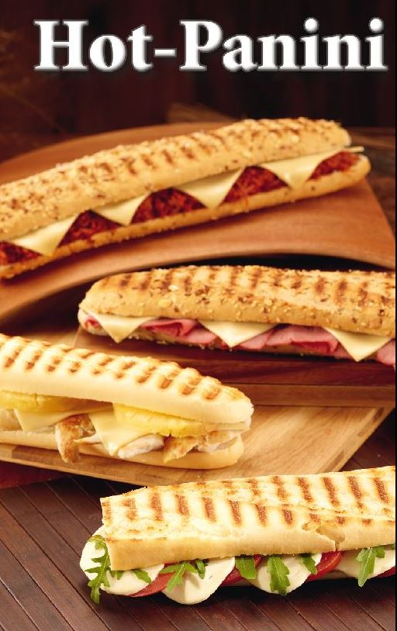
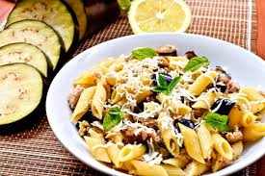
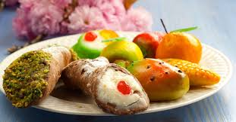
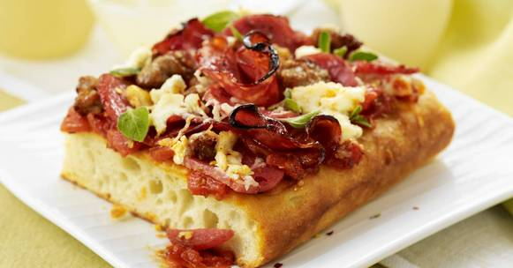
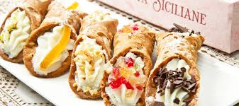
The lifestyle

Slide 9
The departure

Slide 11
My sources
Worksheets from Palermo, Memories from Palermo, Wikipedia

Slide 12
Thank you for listening!

