Slide 1
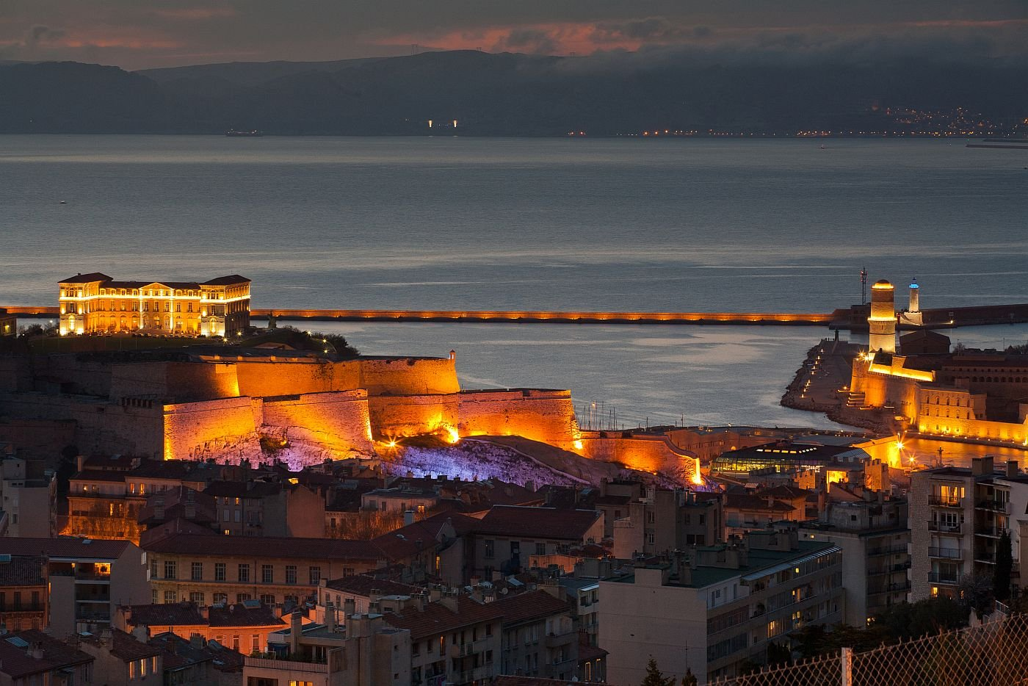
Marseilles

Slide 2
Outline
Marseilles
The History of Marseilles
The old port - ``Le Vieux Port``
Basilica Notre-Dame de la Garde
Chateau d`If
Museum-``MuCEM``
Source list
The End

Slide 3
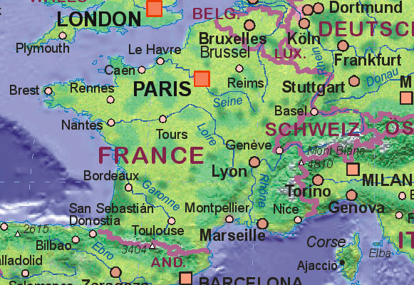

Slide 4
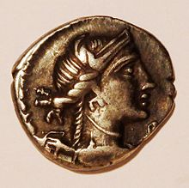
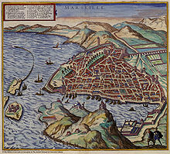
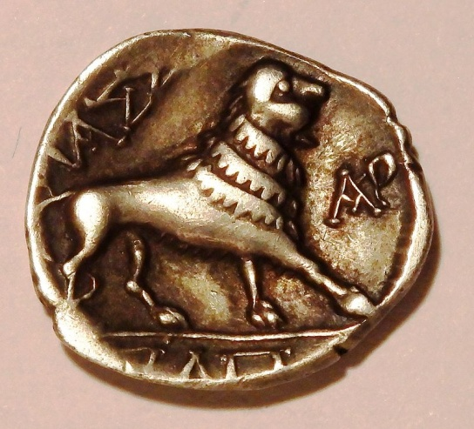
The History of Marseilles

Slide 5
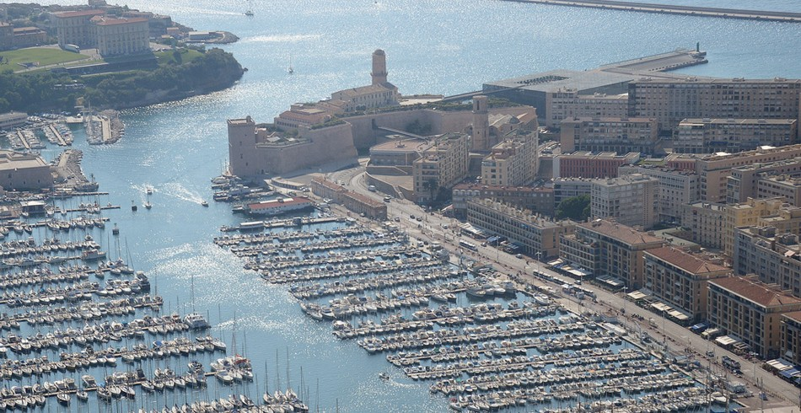
The old port - „Vieux Port“

Slide 6
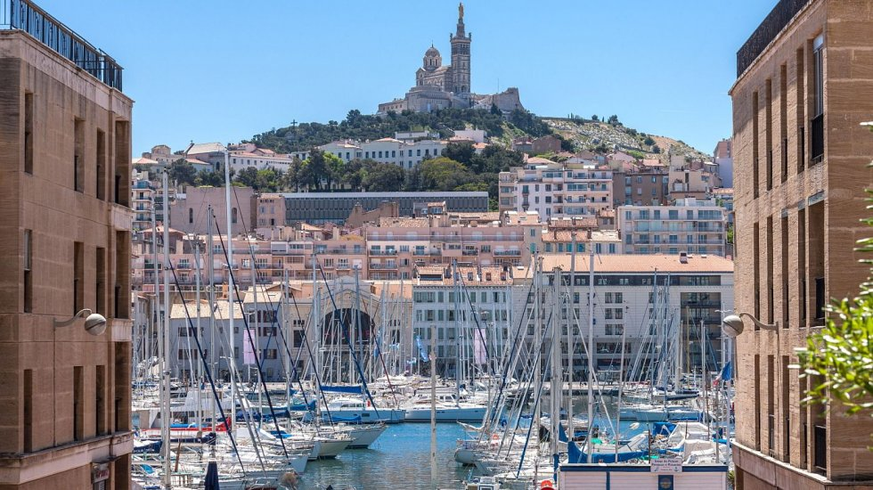
Old Port of Marseille

Slide 7
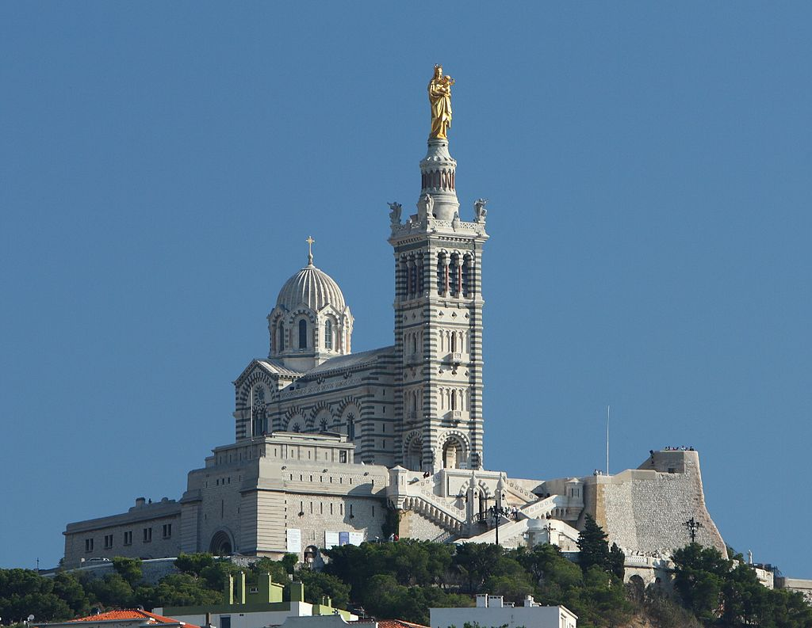
Notre Dame de la Garde

Slide 8
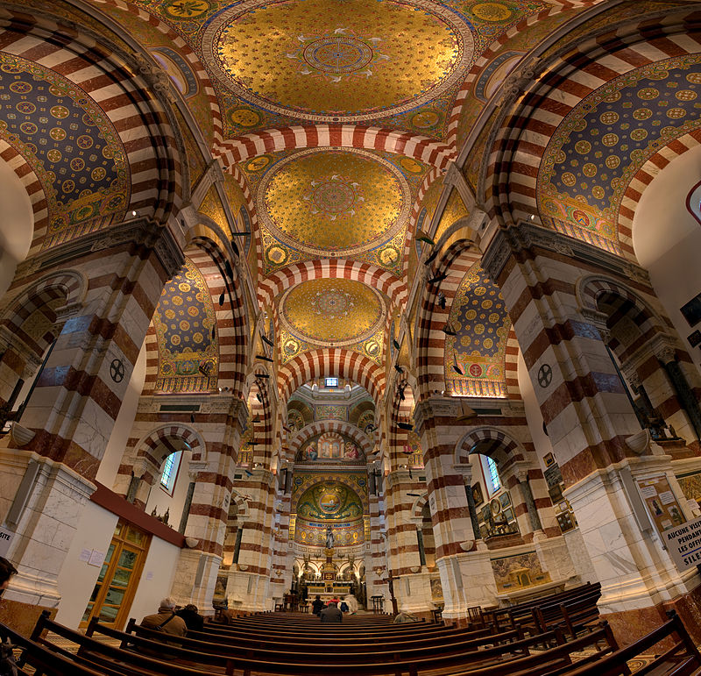
Inside of cathedrale

Slide 9
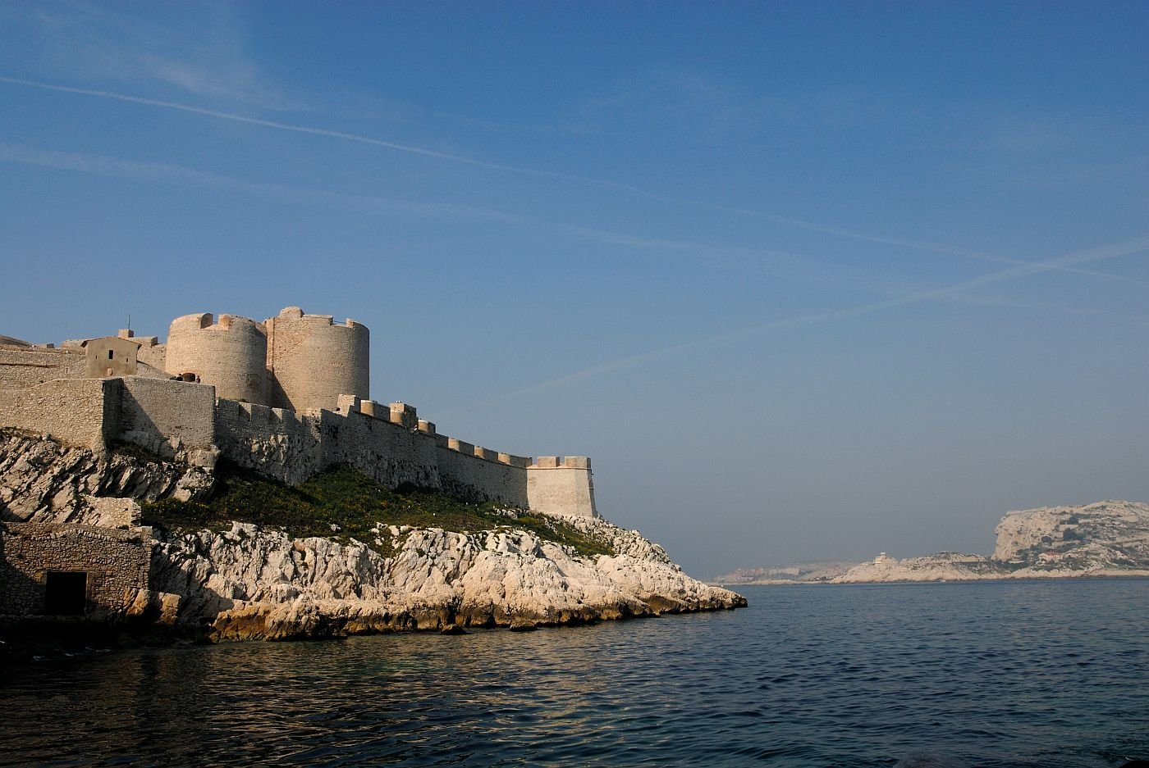
Chateau d‘If

Slide 10
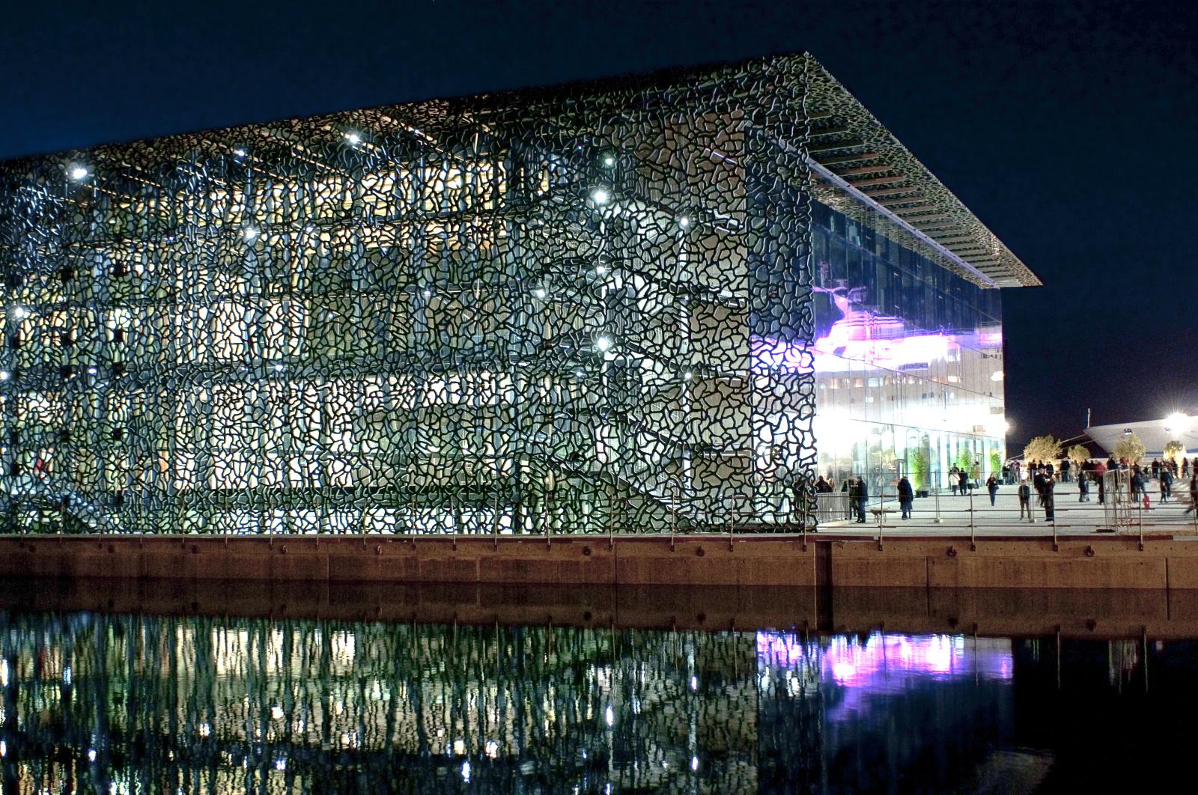
Museum – „MuCEM“

Slide 11
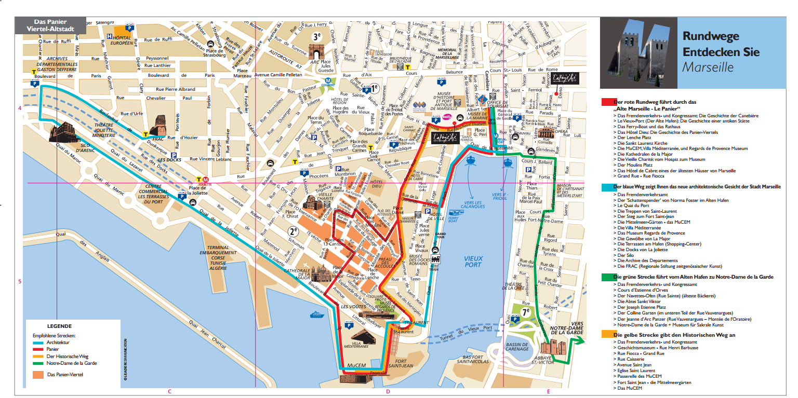

Slide 12
Source list
From the internet (wikipedia)
https://de.wikipedia.org/wiki/Alter_Hafen_(Marseille),
https://de.wikipedia.org/wiki/Notre-Dame_de_la_Garde,
https://de.wikipedia.org/wiki/Marseille,

Slide 13
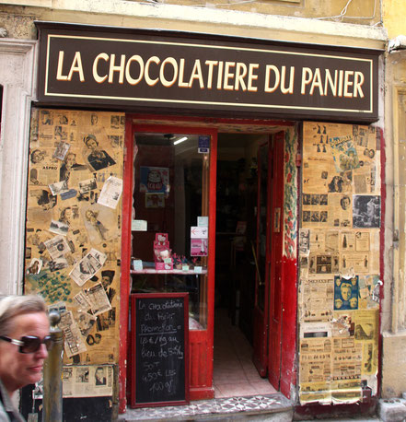
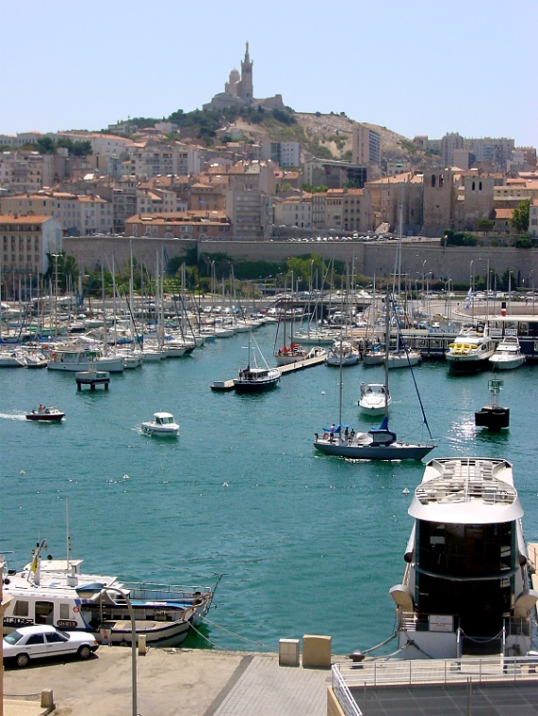
I am looking forward to visiting Marseilles

Slide 14
Thanks for listening
Leonie

