Slide 1
Racism- What can you do about racism ?

Slide 2
What you can do :
Talk with your parents
Talk to the teachers and let them help you
Defend yourself
Ask the classmates why they do that
Do not take to much care about racism you never can make it perfect for everyone
Try to explain why you look like this exmaple : you wear a Hijab , tell them why you wear it not everybody knows the reason and maybe after they know it they exept it and see that not just your appearance is importent

Slide 3
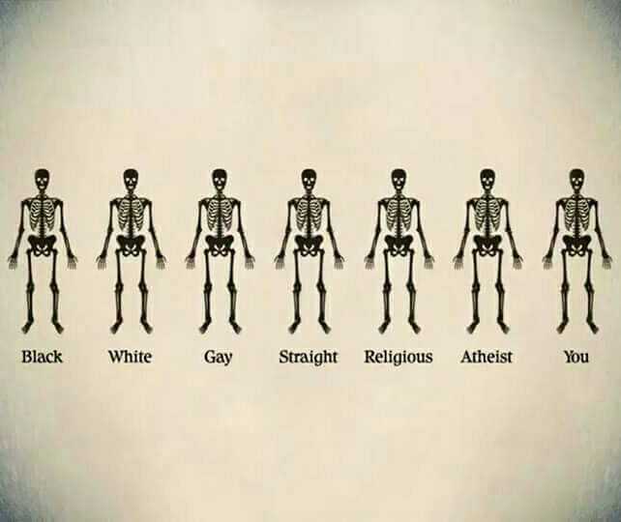
Pictures against racism :

Slide 4
The End
Group : Bader , Vivian, Tamour

