Slide 1
Racism in sports
Today the people cheer the black sportsman, because they are very very good . But few years ago many Afro-Americans were insulted and threatened in the USA. In some sector the racism continues…….

Slide 2
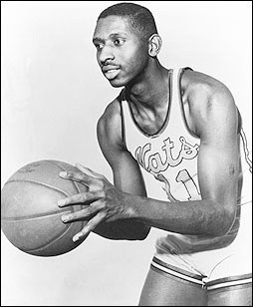
Basketball
Earl Lloyd was an famous basketball player. In 1950 he was allowed to play in the National Basketball Association. But the fans didn’t like it that their team had a black player. However the fans insulted him with “fuck nigger”. But the insults spurred him on.

Slide 3
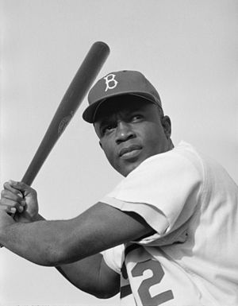
Baseball
The MLB (Major League Baseball) is the oldest professional league in USA. Between 1888 and 1947 there played no black players in this league. Because the team owners had an agreement that no black people was allowed to play in their teams. The black players had their own leagues – the name was the „Negro Leagues“.
Jackie Robinson was the first black player in 1947 in the team of „Brooklyn Dodges“. Robinson has become a symbolic figure for the integration of races in the American professional sport.
Jackie Robinson

Slide 4
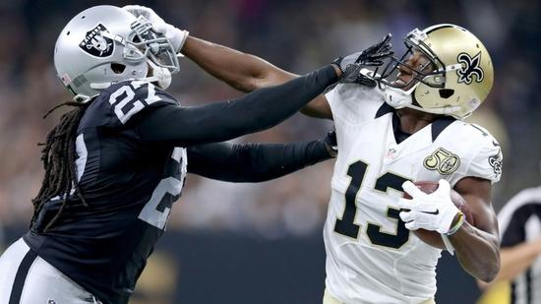
Football
An other example for racism in sports was the fact, that between 1934 an 1946 no black player was allowed to play in the NFL (National Football league). So it was very hart for black people to make sport in a good team and make much money. In 1962 there was a law to integrate the black player. But the black player was not allowed to play in a good position like a quarterback. Because the white people believed that the black people were not so intelligent.

Slide 5
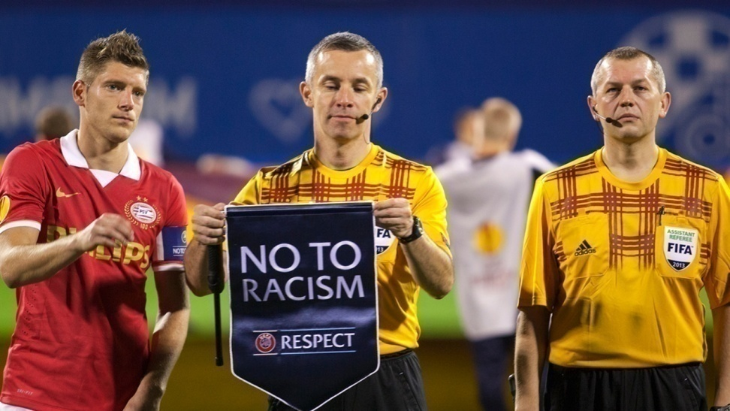
Soccer
Today there are still examples for racism in sports.
Kevin-Prince Boateng is a famous soccer player. He comes from Ghana but he was born in Germany. He plays for a famous soccer team in Mailand/ Italy. In 2013 he left the football field because viewers said to him racist comments. So he left the field and other players too. So they had to interrupt and finished the match.
UEFA-Campaign

Slide 6
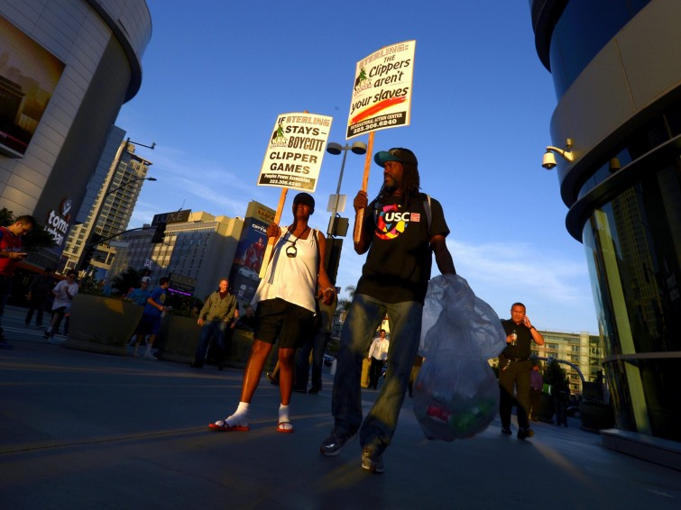
Scandal in basketball
But even today the whites people have the power in basketball. The teamboss Donald Sterling earing million of dollars with the black players. But he insults them with racist sentences. And he thinks and talks like a modern plantagen owner. Donald Sterling is 80 years old. He owns the NBA team LA Clippers for 33 years. But the black players want to defend themselves. (Look at the photo)

Slide 7
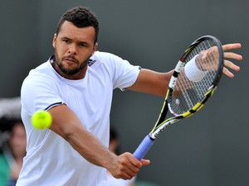
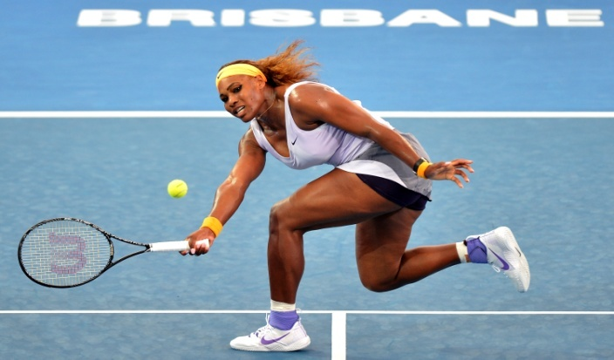
Tennis
Tennis is a „white sport“ for white people. This are hart words. But in tennis there are not much famous colored players. In the last 28 Grand Slams was only one black player . This was Jo Wilfried Tsonga ( e.g. Australien Open in 2008.) At the moment, there are only two dark-skinned players among the top 50 and one player comes from Asia. For women it is a little bit better. Serena Williams an her older sister are very good tennis player. Serena wins 22 Grand Slam matches. But the success of Willam's sisters is not always liked, because they are black and women.

Slide 8
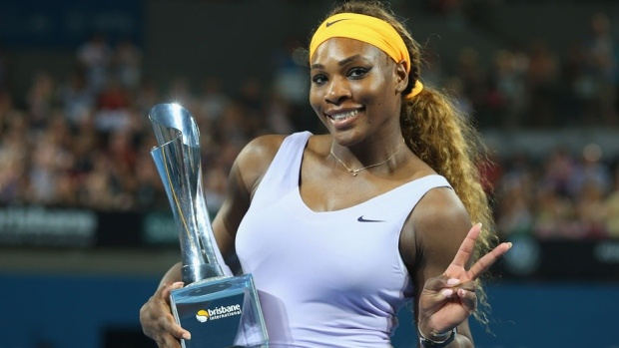
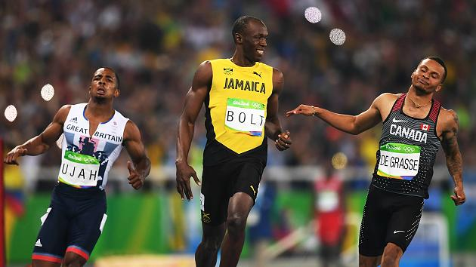
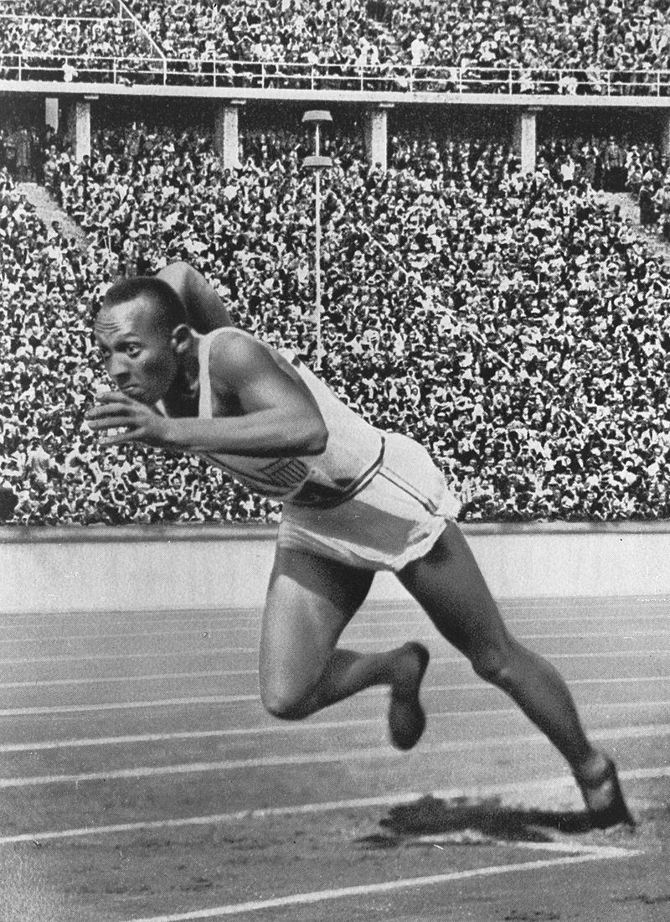
Conclusion
So we see, it‘s hart when your skin has an other color. They are better athletes but they don’t have the same chances as the white ahtletes or players. When their skin has another color, they have to work more for their success.

Slide 9
The End
from Leonie, Marco and Leon

