Slide 1
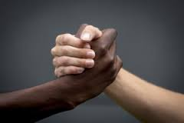
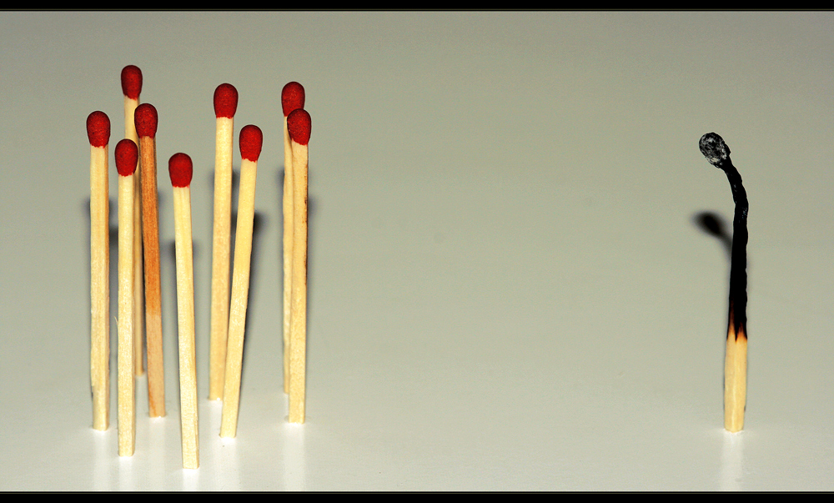
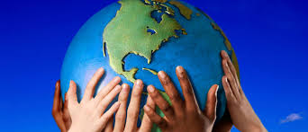
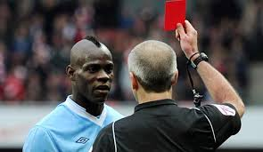

Why are people racist
SAY NO TO RACISM

Slide 2
What is racism
Racism is when someone's treated differently or unfairly just because of their race or culture. People can also experience prejudice, when a decision is made or opinion formed without knowledge, thought or reason, because of their religion or nationality

Slide 3
Racism takes many different forms. These can include:
written or verbal threats or insults
damage to property, including graffiti
personal attacks of any kind, including violence
being treated differently or being excluded because of your race or culture
having people make assumptions about you because of your race or culture
people making racist jokes.

Slide 4
Peolpes are racist
Our views and beliefs develop as we grow up. If you grow up within a family where some members are racist, or have friends who are racist, you may believe that racism is normal and acceptable.

Slide 5
But prejudice of any kind is often based on ignorance and fear of things that are different. Don't fear or dislike what you don't know or understand. Find out more by reading, learning about things online, talking to people and getting lots of different views before you make up your mind.

