Slide 1
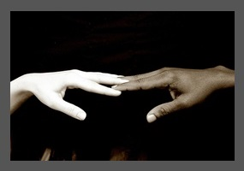
Why is racism a problem?

Slide 2
Racism
A study of over 800 Australian secondary school students found that racism had huge mental health impacts on young people who experience it, including:
Ongoing feelings of sadness, anger , depression and being left out
Headaches, increased heart rate, sweating, trembling and muscle tension
A constant fear of being verbally or physically attacked
Not wanting to go to school
Having little or no trust in anybody apart from family. 1
These impacts can reduce people’s ability to work or study, and to achieve their future goals.
Racism also affects people’s general wellbeing when they are denied equal access to jobs, services and education.

Slide 3
Communities
Racism creates a society where people don’t trust and respect each other.
When it’s allowed to flourish, it lessens us as a people. Remember the Stole Generations… the White Australia policy…these are the ugly times in our history. We need to be vigilant in making sure that these kinds of things are never allowed to happen again.
There are no reasons or excuses for racism. It’s just wrong. And in many cases, racism is against the law.

Slide 4
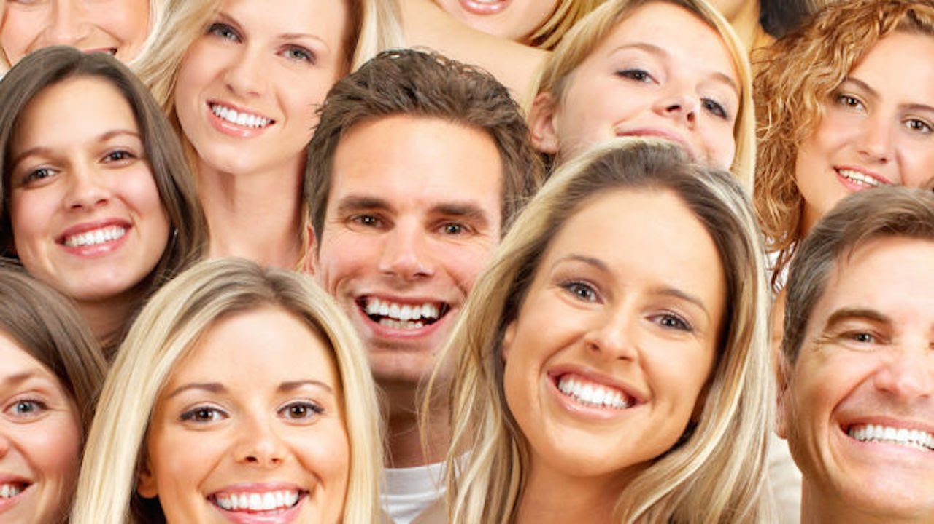
We only hang around with people ´´like us‘‘
It’s normal to want to spend time with people that have the same interests, background, culture and language. It creates a sense of belonging that is really important. The downside is that it can also set up different between other groups and, over time, this might lead to us to thinking that our group is better than others.

Slide 5
We’re quick to judge
We often put labels on people. He dresses like this so he must be into this music. She goes to that school so she must to be rich. We can also stereotype people from different racial backround as ‘’lazy’’, ‘’brainy’’, ‘’aggro’’… you get the idea. The way to beat the stereotypes ? Don’t jugde a whole group. Get to know people from different racial backrounds and find out how much you have in common.

Slide 6
We blame others for our problems
When we feel angry or frustrated, we often look for for someone else to blame for our problems. As a community, we can do the same thing. People who look or talk differently to us are an easy target. You can hear it happening today in comments like, ‘’ those people take our jobs’# or ‘’ they get government handouts all the time ‘’.
Nearly all the time , these statements are wrong.

Slide 7
Racism affects people‘s wellbeing
These impacts can reduce people’s ability to work or study, and to achieve their future goals.
Racism also affects people’s general wellbeing when they are denied access to jobs, services and education.
Racism is the belief that characteristics and abilities can be attributed to people simply on the basis of their race and that some racial groups are superior to others. Racism and discrimination have been used as powerful weapons encouraging fear or hatred of others in times of conflict and war, and even during economic downturns. When we feel angry or frustrated, we often look for for someone else to blame for our problems. As a community, we can do the same thing. People who look or talk differently to us are an easy target. You can hear it happening today in comments like, ‘’ those people take our jobs’ or ‘’ they get government handouts all the time ‘’.

Slide 8
People´s opinion
``If I wasn’t hearing bad things about myself, I wouldn’t think‘‘ oh, I’m a bad person , I can’t do this, I am not going to do it‘‘. Whereas if no one said anything bad about me, I would push myself harder into doing thingsand knowing that I can do it, no matter what happens I will do it ….but I just can’t ‘’
-Ekta 15
‘’Racism makes me question myself and why things have to be this way… I wondered one day what it would be like to be white and how much better my life would probably be. That was a low point.’’
-Andrew, 19

Slide 9
People`s opinion
‘’Why do people continue to be racist after so many articles.videos and talks about how racism is dumb?’’
-Will,15
‘’Why is racism even a thing anymore? Haven’t we moved past that?’’
-Ruby, 16

